Slide 1
Windows server 2019 實戰

Slide 2
AGENDA

Slide 3
Hyper-V

Slide 4
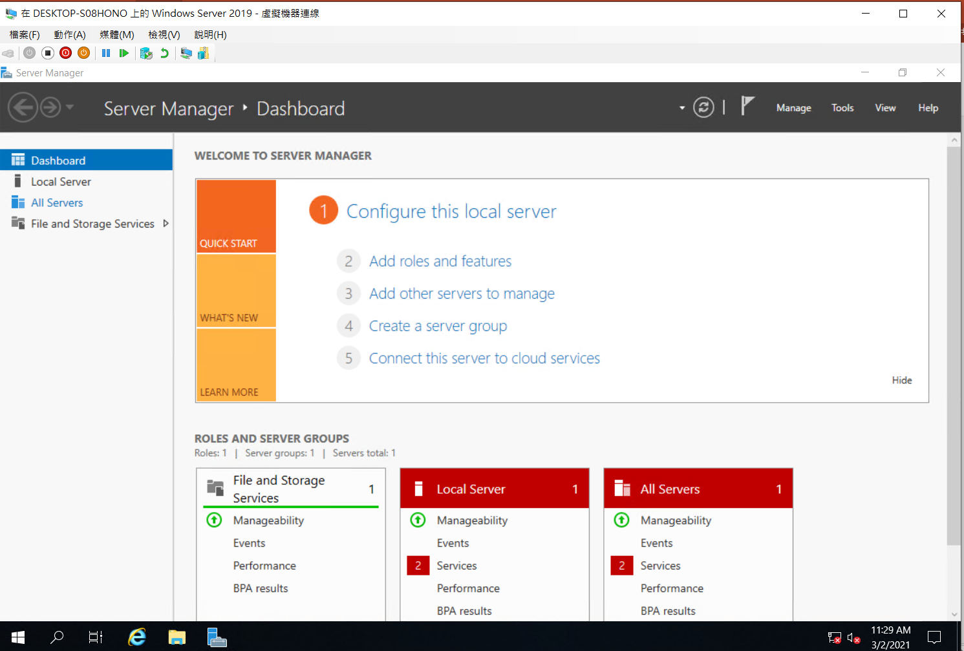

Slide 5
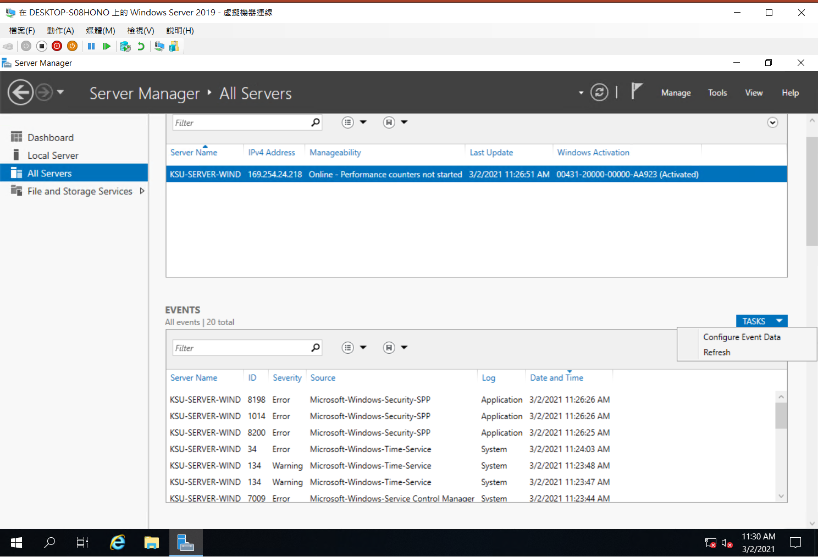

Slide 6
